Slide 1
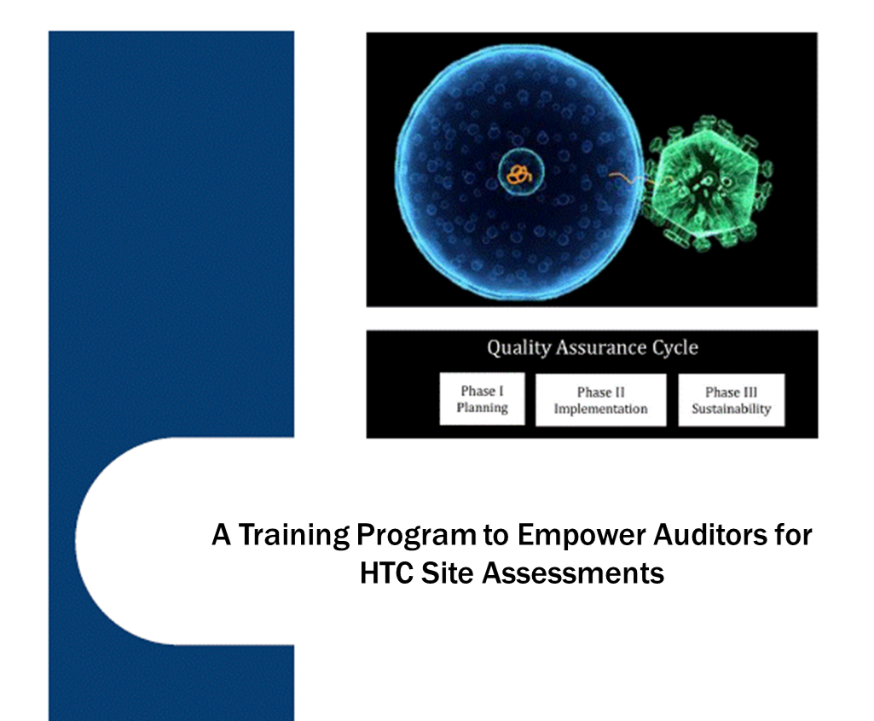
Competency based certification for HIV Rapid Testing Personnel
A Skills Intensive Training Program To Asses HIV Testing Personnel Towards Certification

